Slide 1
Global Government Network (GGN)
GGN
Introduction
Global GC Academy

Slide 2
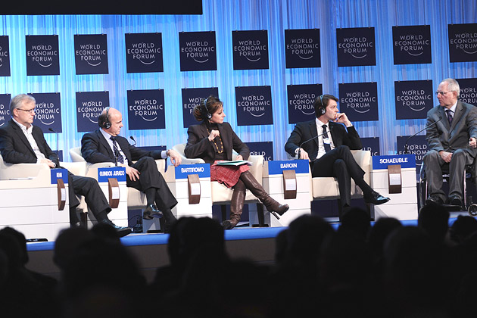
Global Government Network (GGN)
Create a global centre of excellence for Governments on a par with Davos (World Economic Forum) within 5 years.

Slide 3
Tectonic Global Shifts
The physical movement of goods and people continues to challenge Governments.
The freedom of movement of information, whether financial figures, ideas or intellectual property, flows fast across borders.
Fundamental societal changes in personal aspirations, values and expectations of leadership.
By 2050 the World population is expected to increase by 32% and Asia is expected to represent 75% of World GDP.

Slide 4
How GGN fits in
There are many great policy level organisations and communities:
There are few organisations who share how to implement policy at a Department level and those that exist tend to be:
Temporary – addressing a passing issue
Scope – limited to historical relationships and treaties
Bias – in favour of the organising State
Surface – lacking depth of management rigour

Slide 5
The Challenges
There are many challenges including:
Trust, Short-termism & International politics
Culture, Language & Perceptions
and a wide variety of State Governance structures
Germany | UK
Federal Ministry for Economic Affairs and Energy | Department of Business, Skills & Innovation
Federal Minister for Foreign Affairs | Foreign & Commonwealth Office
Federal Minister of the Interior | Home Office
Federal Minister of Justice and Consumer Protection | Ministry of Justice
Federal Minister of Finance | HM Treasury
Federal Minister of Labour and Social Affairs | Department for Work & Pensions
Federal Minister of Food and Agriculture | Department for Environment, Food & Rural Affairs
Federal Minister of Defence | Ministry of Defence
Federal Minister for Family Affairs, Senior Citizens, Women and Youth | Department for Communities & Local Government / & / Department for Culture, Media & Sport
Federal Minister of Health | Department for Health
Federal Minister of Transport and Digital Infrastructure | Department for Transport
Federal Minister for the Environment, Nature Conservation, Building and Nuclear Safety | Department for Energy & Climate Change
Federal Minister of Education and Research | Department for Education
Federal Minister for Economic Cooperation and Development | Department for International Development

Slide 6
GGN Governance & Advisory Panels
Global
Global Advisory Panel (GAP) representing the key Regions (i.e. ASEAN)
Regional
5-10 Regional Advisory Panels (RAP) representing key States (i.e. Egypt)
National
National Advisory Panels (NAP) representing different Government Departments (i.e. Health)
Success Factors
Representative
Independent
Inclusive
Trust Worthy

Slide 7
Benefits Summary
Global Benefits
Global Spend - $18 trillion of Government money better utilised every year
Global Business - Simpler regulatory environment for global business
Society - Greater benefit for the people the Governments serve
State Benefits
Global Centre - Promoting the State as the Centre of Global Government Excellence and the place for global institutions to establish offices
Superior Influence - Superior state knowledge and contacts, reinforcing the State’s leading political influence
Foreign Investment - Foreign Direct Investment (FDI) from States and sponsors, MICE and new World Class local skills
Benefits to Members
World Class - World Class Governance, Best Practice & Benchmarking
Saves Money - Reduced initiative risk, reduced wastage and substantial cost savings
Better Staff - Better informed, well equipped and more effective state employees

Slide 8
The creation process for GGN networks
State Department profiling and sourcing of CxO names
Member engagement and creation of virtual communities
Member research and initial content creation
Planning and Building of Multiple DAVOS level summits
Recruitment and creation of the Global, Regional and National Advisory Panels

Slide 9
Levels & Options
KSA | GCC | Half Global | Full Global
Includes State Departments from of the Kingdom of Saudi Arabia | Includes Saudi Arabia, UAE, Oman, Kuwait, Qatar & Bahrain | Includes GCC, G20, BRICs, Next 11 and States of strategic interest to the UAE | Includes all 190 Nations States in Year One
Phase 1 includes: |  | Phase 2 includes:
Roles: CEOs, CLOs, CHRO, CIOs, CMOs, CFOs, COOs and CDOs (eGov), . |  | Roles: Diplomatic Affairs, Strategic & Corporate Affairs, Public Policy, Chief Planning Officer and Head of Communications.
Departments: Education, Health, Business & Economy, Energy, Foreign Affairs. |  | Departments: Transport, Culture & Communities, Food & Agriculture, Media & Sports, Housing & Infrastructure and International Development.

Slide 10
6 Months Objectives for all Levels
A trained team in place
A database of the key people, in the agreed departments and key countries
Online communities of the State Departments CxOs
A brilliant website that supports the community
Research with all the CxOs on what they want their network to address
The network generating content such as Case Studies to share with members
Identified and recruited speakers for the summit in the latter half of the year
All the infrastructure will also be in place, such as our Tech, Templates, Links, Management Processes and Reporting.

Slide 11
Your GGN Contacts
Enquiries
John Jeffcock, Chief Executive Officer
Call: +44 207 605 8000
Email: john.jeffcock@winmarkglobal.com
Coordination
Monica Barsan, HR & Training Manager
Call: +44 207 605 8000
Email: monica.barsan@winmarkglobal.com
Email: hello@winmarkglobal.com or call +44 (0) 207 605 8000
Follow us on LinkedIn
Winmarkglobal.com
Winmark Global
7 Berghem Mews
Blythe Road
London
W14 0HN
United Kingdom

